Slide 1

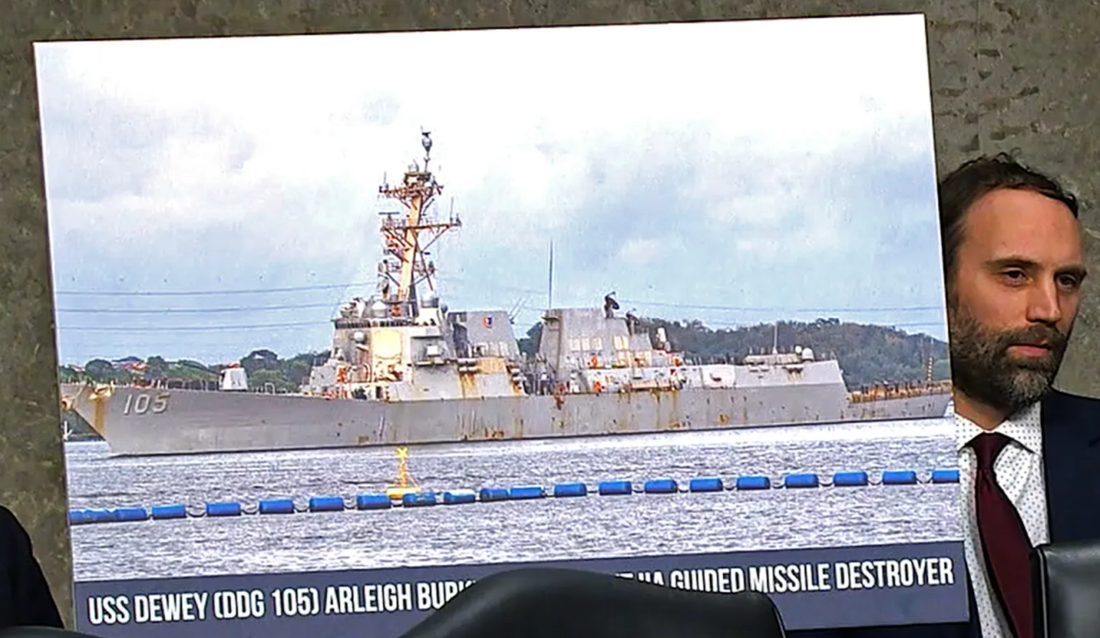

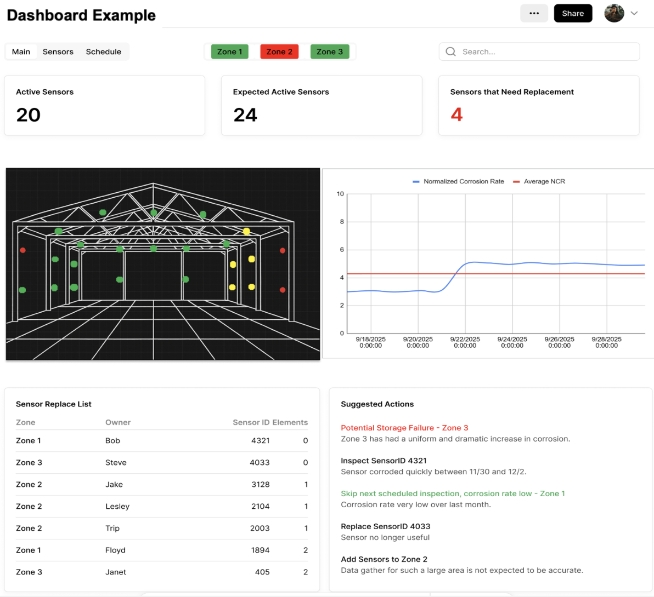
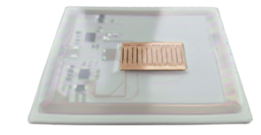


Mandy@AmbientSenseTech.com - (503) 708-0903 - www.AmbientSenseTech.com
AmbientSense Technologies
Corrosion Monitoring: Affordable Sensors & AI Predictive Software for Cost Optimization and Predictive Maintenance
PROBLEM STATEMENT
Reactive, manual inspections miss early corrosion → downtime, high maintenance, system failures.
Corrosion mitigation is $20.6B/yr for DoW
BENEFITS
Reduce corrosion sustainment costs by up to 30%
25–50% fewer unscheduled maintenance events
Low-cost ($25-$75 per unit) solution scalable
Large data sets -> AI based prediction models
TECHNOLOGY SOLUTION
Affordable, scalable active and passive RFID corrosion sensors and AI predictive models enable operations to get real data on corrosion
Optimize maintenance ROI, decrease downtime, avoid catastrophic failures, predictive maintenance.
Dual-use Applications:
Mitigation ROI |  | Compartments, containers |  | Shipping containers, stored equip
Corrosion Alarm |  | Prepositioned equip,, wrapped equip |  | Shipping container, storage unit
Precision Monitor |  | Warehouses, bases, field storage |  | Factories, refineries
Corrosion Sensor Illustration
DoW
Commercial
Reading a corrosion sensor
Closeup of corrosion detection
AmbientSense Technologies Inc. – Confidential and Proprietary

