Slide 1

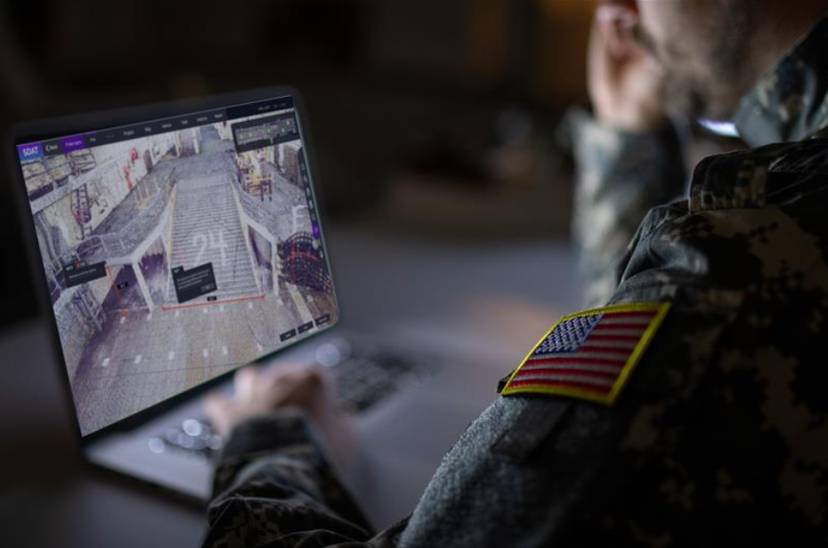
Design Mill, Inc.
Digital Twins with AI
PROBLEM STATEMENT
Defense and industrial organizations operate complex physical environments where critical information is often fragmented across drawings, 3D models, sensor systems, databases, imagery, documents, and institutional knowledge.
Planning, transportability assessment, facility management, training, logistics, and operational analysis can still depend on manual measurements, physical site visits, disconnected applications, and time-intensive interpretation of data.
The result is slower decision-making, increased cost and travel, limited situational awareness, duplicated effort, and difficulty maintaining an accurate understanding of changing assets and environments.
Organizations need a secure digital operating environment that connects physical reality, operational data, and AI to support faster, better-informed decisions.
BENEFITS
ViPr transforms physical environments and operational information into an interactive, AI-enabled digital twin that can be accessed remotely by engineers, planners, operators, maintainers, and decision-makers.
The platform enables organizations to:
Improve mission planning, logistics, readiness, and transportability
Reduce physical site visits, manual measurements, travel, and operational disruption
Visualize facilities, equipment, infrastructure, and mission assets remotely
Perform precise 3D fit, clearance, collision, routing, and spatial analysis
Connect IoT, operational systems, documents, imagery, and asset information into a common environment
Use AI to search, summarize, analyze, and reason across approved operational information
Preserve institutional knowledge and accelerate training
Improve asset utilization, facility planning, workflow efficiency, and lifecycle decisions
Create a scalable foundation for continued AI, automation, and digital transformation
This moves the digital twin beyond visualization into a decision-support environment for real-world operations.
TECHNOLOGY SOLUTION
Design Mill’s ViPr platform is a secure, cloud-based digital twin solution that combines reality capture, 3D models, geospatial data, IoT, enterprise information, and AI into a shared operational environment. ViPr enables users to visualize and analyze real-world assets, perform fit, collision, clearance, routing, and spatial analysis, and remotely assess facilities and equipment. AI adds asset- and location-aware search, analysis, and decision support across approved operational data, helping users turn complex physical and digital information into faster, more actionable insight.
GRAPHIC

